Slide 1

Entity Framework core
Lecturer
Rokas Slaboševičius
Data

Slide 2
Today you will learn
Entity Framework core
What is Entity framework core?
01
How do I create a Code-first database?
02
How do I add/remove data from the database?
03

Slide 3
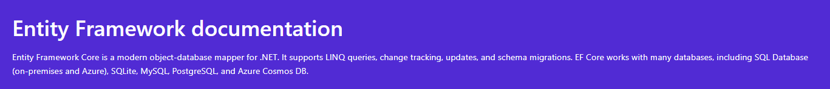
What is the Entity Framework?
Entity Framework core
https://docs.microsoft.com/en-us/ef/

Slide 4
Entity Framework implementation
Entity Framework core
For more instructions on how to install the Entity framework: https://docs.microsoft.com/en-us/ef/core/get-started/overview/first-app?tabs=visual-studio

Slide 5
Deploying Entity Framework in Visual Studio
Entity Framework core
Tools > NuGet Package Manager > Package Manager Console
Enter the command 'Install-Package Microsoft.EntityFrameworkCore.SqlServer -Version 5.0.10' into the console

Slide 6
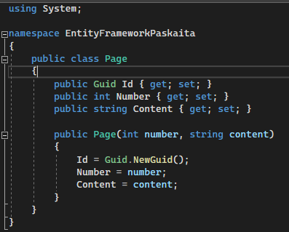
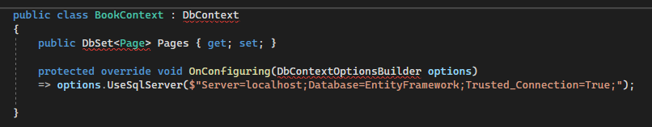
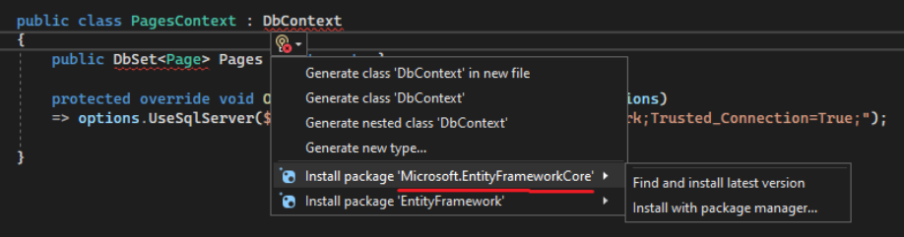
Model development
Entity Framework core
We create a class called Page
We create a class called BookContext, this class will be the interface between the Page class and the Page table in the database
We inherit from the DbContext class and create a DbSet list of Page objects
I also override the OnConfiguring method with my connection string
Note the library when selecting EntityFrameworkCore

Slide 7
Model development
Entity Framework core
The first Code-first migration is now available.
Enter the command 'Install-Package Microsoft.EntityFrameworkCore.Tools -Version 5.0.10'
Next command 'Add-Migration InitialCreate'
Last command 'Update-Database'

Slide 8
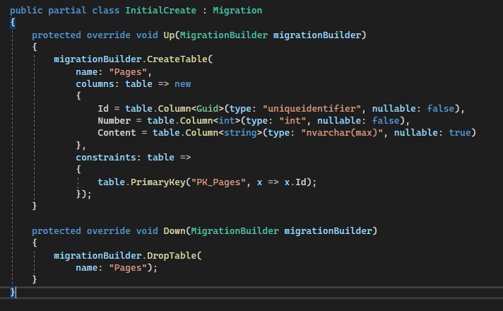
Model development
Entity Framework core
Let's review what happened.
The Add-Migration command collected the changes that occurred in the database context.
In this case, a DbSet was created with the Page class.
The migration class itself looks like this:
We can see that the code has created a table and columns and a PK.
We can also see the Down method if we want to downgrade data
base, the team would be:
Update-Database -TargetMigration : <MigrationName>
In this way, the framework would "roll back" the migration.

Slide 9

Model development
Entity Framework core
When we open the database, we also see the created table Pages and EFMigrationsHistory

Slide 10
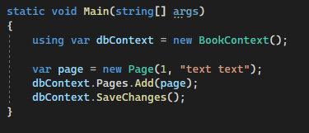
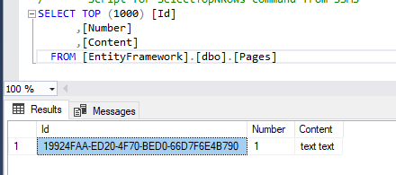
Use of the model
Entity Framework core
We try to add data
All it requires is to create a DbContext object and add it to the DbSet
list of objects.
Don't forget to save with SaveChanges()!

Slide 11
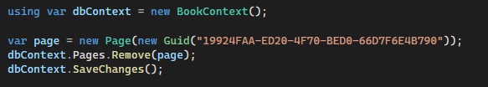
Deleting data
Entity Framework core
All you need is to create an object with the Id object,
which we want to delete and call the Remove method.
Save changes in context

Slide 12
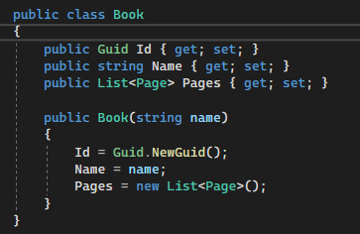
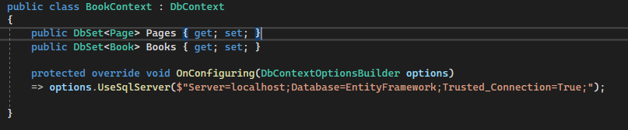
Add an additional model
Entity Framework core
Let's create a parenting model for the Page class called Book.
Let's add the model to the BookContext class.

Slide 13
Add an additional model
Entity Framework core
Let's perform a new migration to trigger the changes.
Add-Migration AddedBookModel
Update-Database

Slide 14
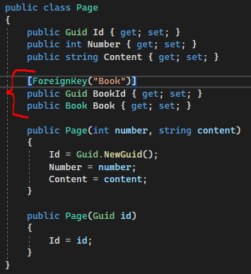
Add an additional model
Entity Framework core
Now we have a table in the Books database,
but it doesn't link to the Page table in any way.
Let's update the Page class to show that it is a kid's class for Book class.
After adding these new fields, we perform a new migration and database update.

Slide 15
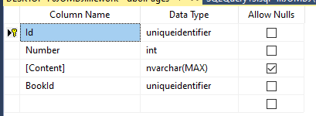
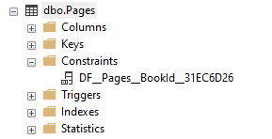
Add an additional model
Entity Framework core
We see a new field in the table 'BookId'
We also see a new Constraint

Slide 16
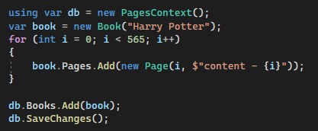
Add an additional model
Entity Framework core
We create a book with a list of pages and save it to the database.

Slide 17
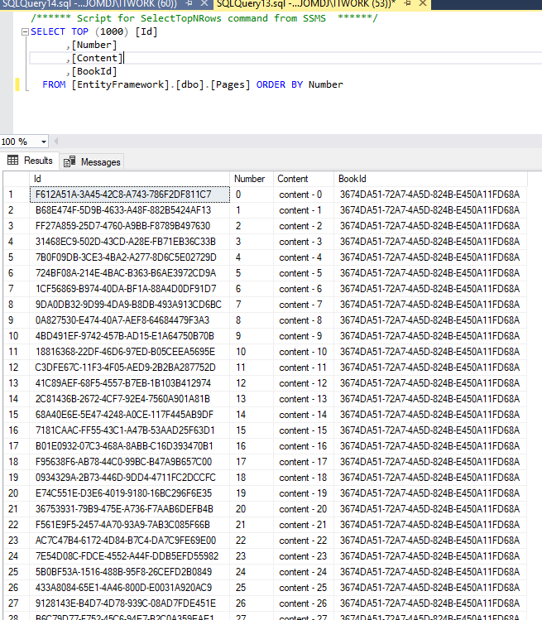
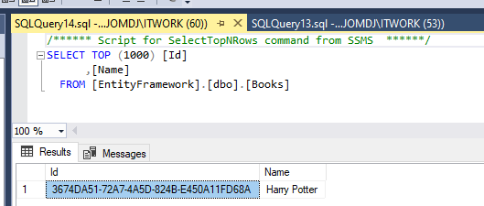
Add an additional model
Entity Framework core
Check database entries.

Slide 18
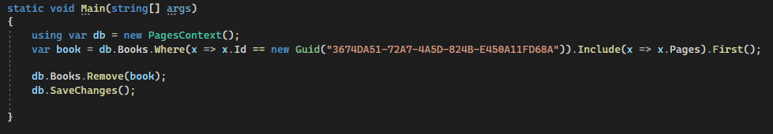
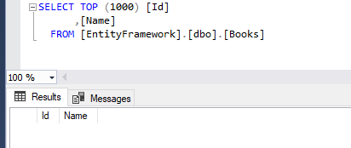
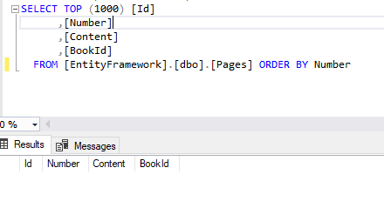
Deleting parents (models) with children.
Entity Framework core
To delete a parent element with children, we need to pull them out of the database together.
This will require the LINQ Where and Include methods.
As we can see, the data has been deleted:

Slide 19

Entity Framework core
Task 1
Redesign the c# advanced 16 slide to use a database instead of files;

Slide 20
Lecture title
Headline
www.youtube.com
Useful information

